Slide 1
Welcome to Live Lecture
Week 6 Agenda
Moderator: Gina Cooper
GUI Applications
Windows Forms
Classes and Objects
Questions

Slide 2
Contrasting Windows and Console Applications
Console applications
Each line in Main( ) executed sequentially – then the program halts
Calls Operating System for I/O
Windows applications
Once launched, sits and waits for an event
Sits in a process loop
Reacts to event notifications from Operating System
Event: notification from operating system that an action, such as the user clicking the mouse or pressing a key, has occurred
Write event-handler methods for Windows apps

Slide 3
Windows Forms
A form contains objects with which the user can interact
Extensive collection of Control classes that the objects inherit methods from
Control class has methods such as show() and hide()
Top-level window for an application is called a Form
Each control has large collection of properties and methods
Select property from an alphabetized list (Properties window)
Change property by clicking in the box and selecting or typing the new entry

Slide 4
Windows Applications
To create: Start -> New Project -> Windows Form Application
Give it a meaningful name
Notice the Class libraries at the top of your screen!
Building Windows form applications
Create and organize a user view's form and its controls
Respond to user interaction and commands (eg buttons) via event handlers

Slide 5
using System.Windows.Forms; // Line 1
namespace Windows0
{
public class Form1 : Form // Line 2
{
public Form1( ) // Line 3
{
Text = "Simple Windows Application"; // Line 4
}
static void Main( )
{
Form1 winForm = new Form1( ); // Line 5
Application.Run(winForm); // Line 6
}
}
}
New namespace referenced
Base class
Constructor
Sets title bar caption
Starts process loop

Slide 6
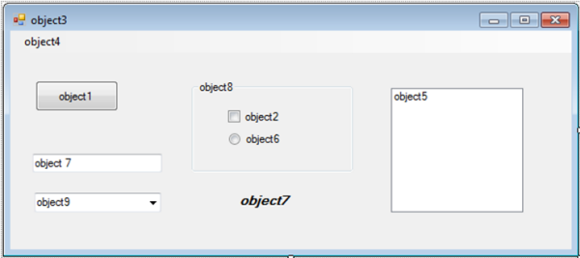
Objects
Checkbox: object2
Menu strip: object4
Listbox: object5
Radio button: object 6
Group box: object 8
Label: object7 (in italics)
Form: object3
Button: object1
Combobox: object 9
Textbox: object7

Slide 7
Objects
Label = provides descriptive text to let the user know the purpose of another control such as a textbox
Textbox = accepts text input from the user and can be used to display text
Button = can be clicked by the user to make the application perform a specific task
Radio button = mutually exclusive (can only choose 1)
Check box = can choose several
Group box control = multiple radio buttons are placed together on a group box control so the user can select only one

Slide 8
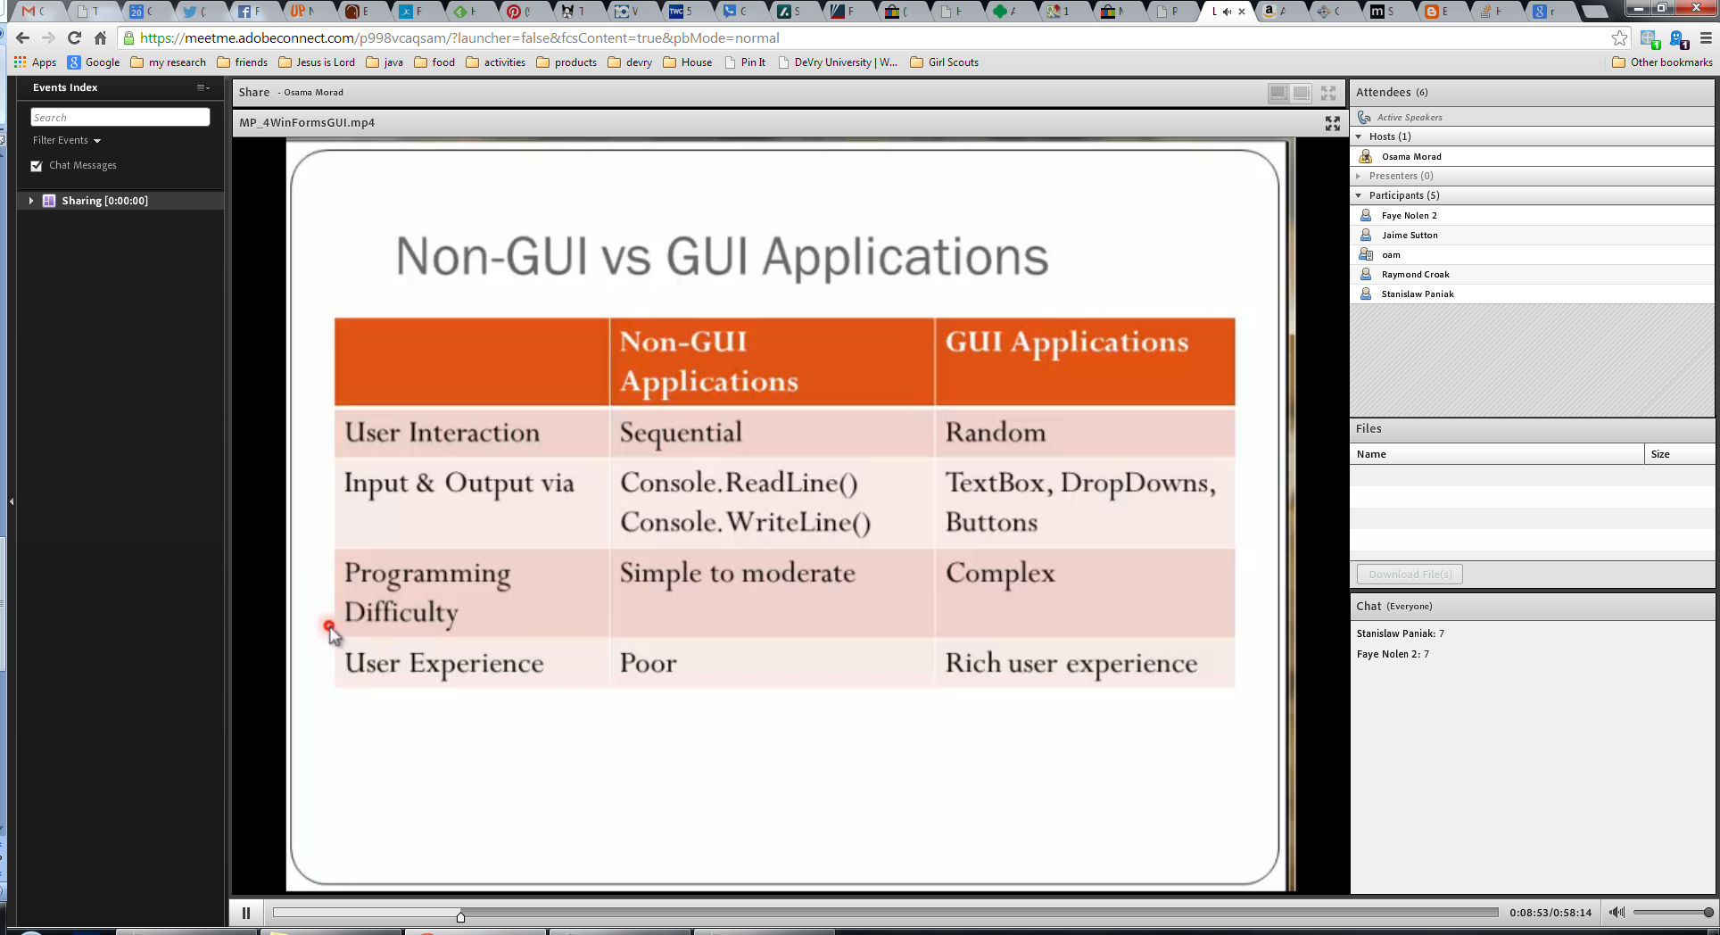

Slide 9
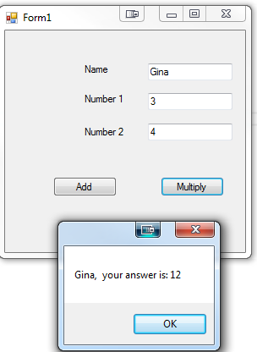
GUI Application Example
Create a GUI application to add or multiply two numbers and display the user's name. You will need: three labels, three text boxes and two buttons. The user should enter their name in the first text box and a number in the other two textboxes One button should be named Add and the other Multiply.
Change the names of all controls
When they press the button, a messagebox should show the result.
Notes:
Console.Write("How many random numbers should we test: ");
int num = int.Parse(Console.ReadLine());
int i = 1;
int smallest=100;
int largest=0;
Random random = new Random();
int randomNumber = 0;
int count = 0;
for (i = 0; i < num; i++)
{
randomNumber = random.Next(0, 100);
if (randomNumber > largest)
{
largest = randomNumber;
}
if (randomNumber < smallest)
{
smallest = randomNumber;
}
if (randomNumber % 2 == 0)
{
count++;
}
}
Console.WriteLine("The number of even values generated was {0}. \nThe smallest value was {1} and the largest value was {2}", count, smallest, largest);

Slide 10
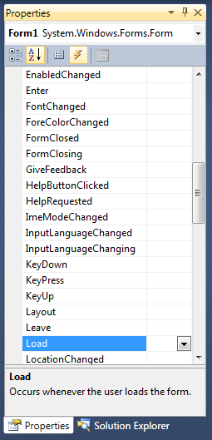
Windows Form Events
Add code to respond to events, like button clicks
Double click a form object in design mode to open the default event handler
Form default event handler method is Load()
Button default event handler method is Click()
Textbox default event handler method is textChanged()
Checkbox default event handler method is checkChanged()
Events button selected

Slide 11
Adding an Event to our Example
Double click on the Add button
private void btnAdd_Click(object sender, EventArgs e)
{
string name = txtName.Text;
int num1, num2, ans;
num1 = Convert.ToInt32(txtNum1.Text);
num2= Convert.ToInt32(txtNum2.Text);
ans = num1 + num2;
MessageBox.Show(name + ", your answer is: "+ans);
}
Can also use a label and use lblDisplay.Visible = true

Slide 12
Message Box
MessageBox = Predefined class that can be used to display information to users through the Show() method member
MessageBox buttons:
MessageBoxButtons.AbortRetryIgnore
MessageBoxButtons.OK
MessageBoxButtons.OKCancel
MessageBoxButtons.YesNoCancel
MessageBox.Show(input+"Do you love cis170?", "title for my message box",MessageBoxButtons.YesNoCancel);

Slide 13
Testing Message Box
To test and see if a certain value is checked use DialogResult
Example:
If(MessageBox.Show(input+"Do you love cis170?", "title for my messagebox",MessageBoxButtons.YesNoCancel) == DialogResult.No)
{
MessageBox.Show("bummer");
}

Slide 14
Random Values Review
Random random = new Random(); int randomNumber = random.Next(0, 100);
Will produce a random number between 0 and 100
Need to use random numbers for lab this week
See rock, paper, scissors game

Slide 15
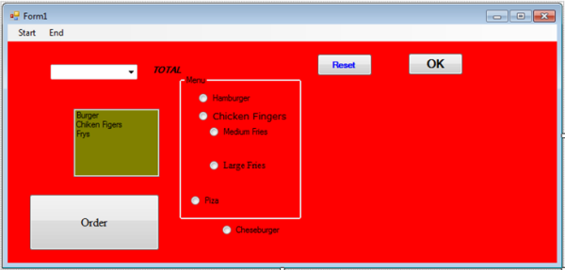
Elements of Good Design
Appearance matters
Design considerations
Consistency
Alignment
Avoid clutter
Color
Target audience
List some design errors in the following GUI

Slide 16

Key concepts
Windows Forms
Controls
Event handlers

